Slide 1
Burning economic issues
Q3 GDP surges to 1.4% on strong oil production (2.03mbpd)
Agricultural sector maintains momentum (3.06%)
Nigerian $3bn Eurobond 4times oversubscribed
Pricing at 6.45% p.a.
Nigeria underperforms in MO Ibrahim report on corporate governance
Naira depreciates by N1 to N365/$ in parallel market

Slide 2
Economic News
Good News
Agricultural sector sustained performance (3.06%)
In response to lower interest rates (intervention funds)
GDP growth and moderating inflation may force MPC to rethink
Diesel price flat at N200/litre
Bad News
Interest rate sensitive sectors shrink
GDP numbers show vulnerability to exogenous shocks
OPEC strict enforcement may hurt Nigeria in Q4

Slide 3
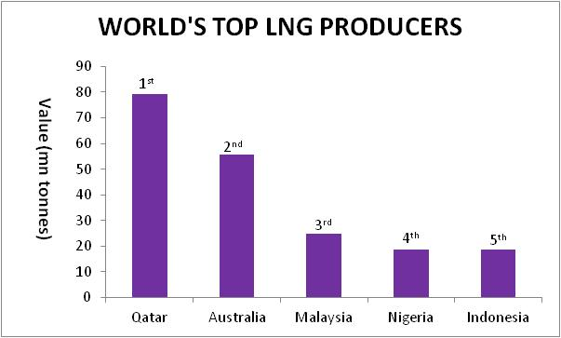
Commodity in focus - LNG
Total Global Production: 286mn tonnes, 2018 growth forecast- 5.8%
World’s top LNG Producers: Qatar, Australia, Malaysia, Nigeria
World’s top LNG consumers: Japan, South Korea, China, India
LNG price increased by 19% in 2017
Major uses: heating, cooking, electricity generation, fuel, etc
Pertinent threat: Rising U.S shale output
Source: Economist Intelligence Unit, FDC Think Tank

Slide 4
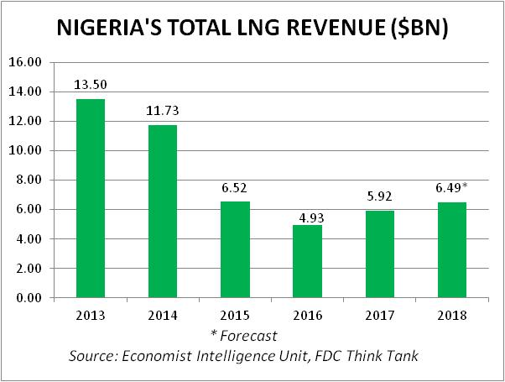
LNG in Nigeria- HUGE reserves, WEAK sales
Nigeria’s LNG export (2017): 18.6mn tonnes (6.5% of global exports)- $5.92bn
Rank in proven gas reserves: Global- 9th, Africa- 1st
Rank in natural gas production: Global- 17th, Africa- 2nd (After Algeria)
Major Threat: Mozambique

Slide 5
Power Generation analysis & Impact
November 16th: Average power output sent was 3,825MWh/hour (down 84.63MWh/h)
Gas constraint was 1,078MW; frequency management constraint due to loss of DisCo feeders was 216.1MW, water management constraint was 150MW
Estimated loss: N0.75bn (annualised at N273.75bn /$0.76bn)
Shiroro Hydro has commenced water management measures to ensure dry season efficiency

Slide 6
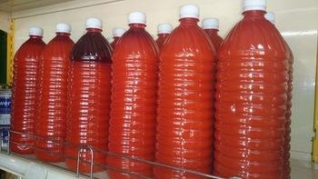
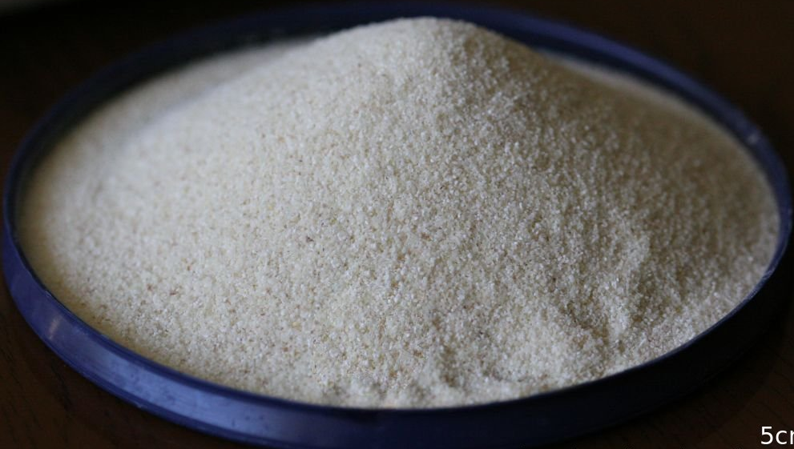
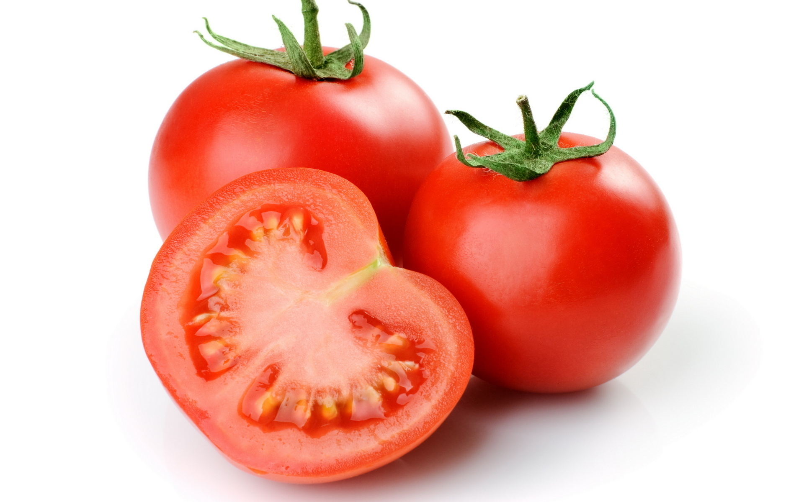
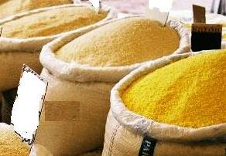
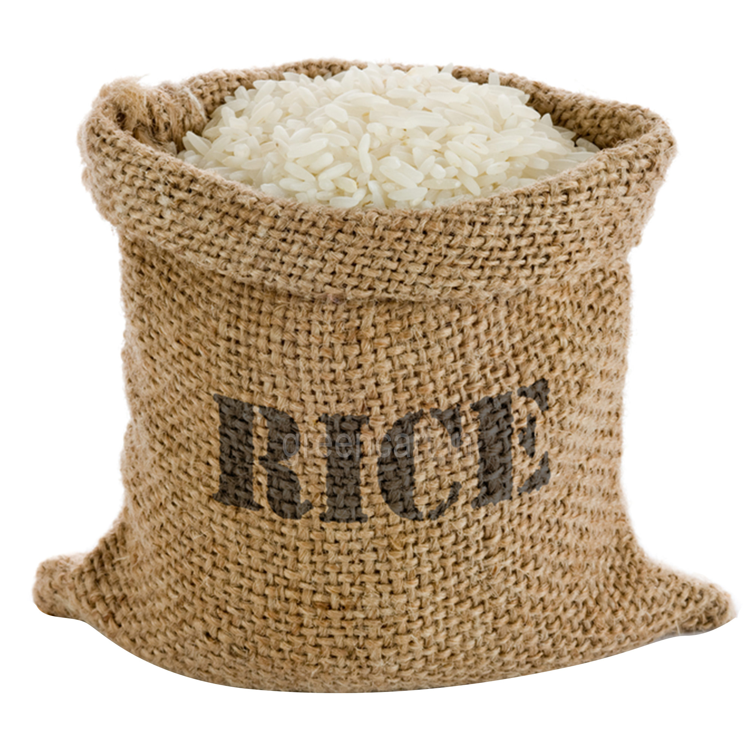
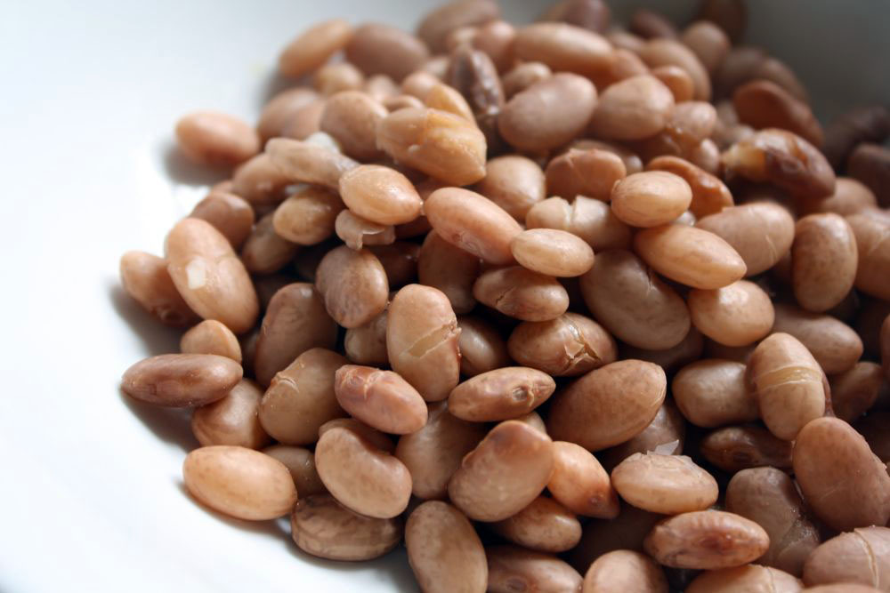
Domestic commodity price movement
CURRENT PRICES(LAGOS)
Lagos Price
Commodities
CURRENT PRICES
PREVIOUS PRICES
DIRECTIONAL CHANGE
1 year Low
1 year High
Palm Oil (25L)
N13,000
N13,000
N6,000
N25,000
Semolina(10kg)
N1,800
N1,800
N1,800
N3,500
Price Elastic
New Yam(small tuber)
N650
N650
N900
N650
Tomatoes (50kg)
N8,000
N8,000
N8,000
N28,000
Garri (50kg)
N10,500
N10,500
N8,000
N16,000
Rice (50kg)
N15,000
N15,000
N13,500
N22,000
Price Inelastic
Flour (50kg)
N9,806
N10,000
N8,500
N11,000
Sugar (50kg)
N16,000
N16,000
N8,000
N20,000
Beans (Oloyin) (100kg)
N28,000
N28,000
N12,000
N34,000
Cement (50kg)
N2,700
N2,700
N1,400
N2,700

Slide 7
Consumer Goods – Current Price Lagos
GOODS
Street price
Supermarket price
% difference
Pepsi (50cl)
N100
N90
-10%
Beer (60cl)
N250
N280
-10.71%
Bread Loaf
N350
N400
-12.5%
Indomie (1 carton)
N1,900
N2,100
-15.5%
Gala (big size)
N100
N100
0%
Domestic prices remain flat

Slide 8
Stock market
NSE ASI 0.74% to 36,792.6pts
Consumer goods sub index 0.52% to 894.38 pts
 | Share Prices (N) | Daily % Change 20 Nov -21 Nov | YTD (%)
Nestle | 1,255 | 0.4 | 55
Honeywell | 1.93 | 2.00 | 50
Flourmill | 34.89 |  | 89
Cadbury | 11.20 |  | 5
NB | 138.50 | 0.11 | 0.3
Dangote Sugar | 14.95 | 5 | 150
Unilever | 37.00 | 3.00 | 11.00

Slide 9
Oil Prices
Brent crude 0.39% to $61.48pb
On an unexpected jump in U.S shale output
Concerns of global demand also weighed on prices

Slide 10
Oil markets today
COMMODITY
WEEKLY CHANGE
17 Nov – 20Nov
YTD
CURRENT PRICE
OIL
BRENT
WTI
NATURAL GAS
0.39%
0.61%
0.32%
11.83%
5.85%
15.86%
$61.48pb
$54.99pb
$3.16MBtu

Slide 11
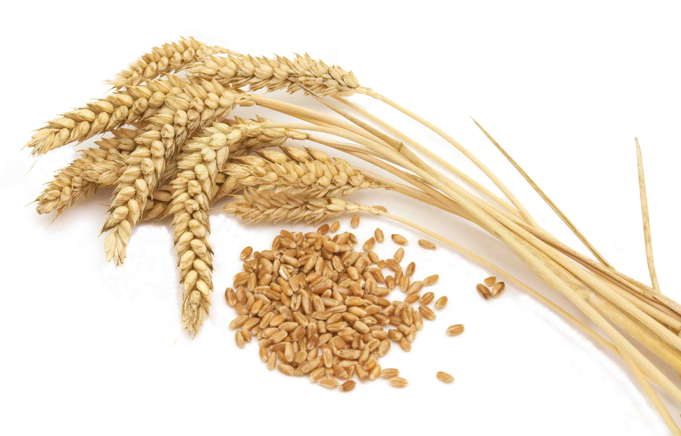
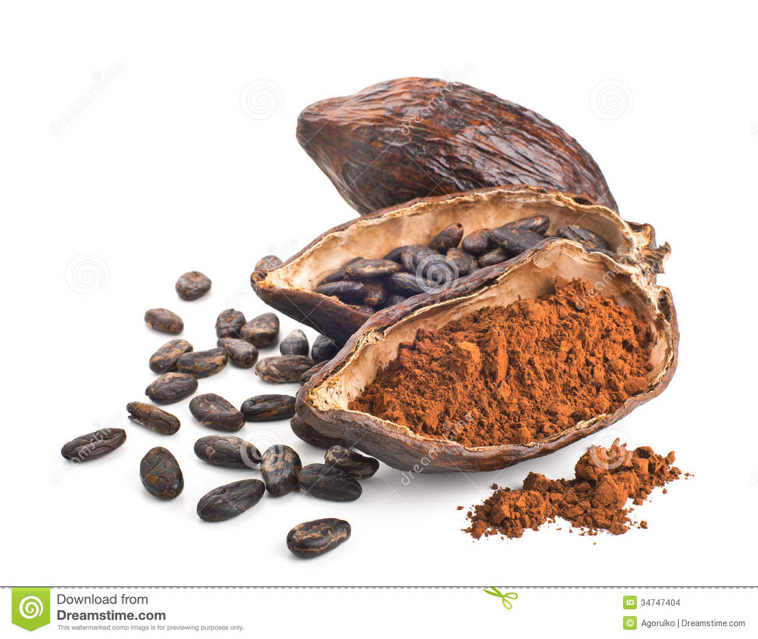
Agric commodities
Wheat
Corn
Cocoa
Sugar
Graphic
Design
Wheat futures down 0.35% to $4.25/bushel
Prices under pressure due to improved crop conditions in the U.S
Corn futures down 0.22% to $3.47/bushel
Expectations of higher corn yields weighed on prices
Cocoa prices up 1.45% to $2,054/mt
Ivory Coast’s production is expected to drop 12% by year end
Sugar prices down 0.14% to $0.1470pound
Partly driven by forecasts of lower production in 2018.

Slide 12
Outlook – Oil prices
Prices likely to remain above $60pb in the near term
On-going tensions in the Middle East will continue to support market.
However, resurgence in U.S output will cap gains.

Slide 13
Outlook – agric prices
Bumper U.S harvest to keep prices bearish
Grains
SUGAR
Prices will be determined by supply/demand dynamics
COCOA
Lower production forecasts in Ivory Coast will continue to support prices
Softs

