Slide 1



Burning Economic Issues
  Financial System Stability report released
  Inflation to dip further to 11.2% - FDC
  Oil production up (1.73mbpd), rig count flat (14)
  External Reserves up marginally (0.02%) to $44.69bn
  Retail diesel price flat within the range of N230-240/ltr

Slide 2




Impact
The Goodies
The Downers
Further decline in inflation is positive for policy makers
Oil prices are 18% above budget benchmark
  Positive for fiscal and external accretion
    IMF cuts global growth forecast to 3.3%
      Lowest level since financial crisis

Slide 3
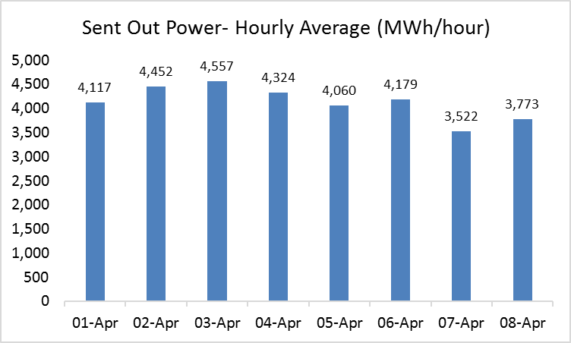
Power Sector
State | Temperature(noon-time)
Abuja | 32⁰C
Kano | 38⁰C
Lagos | 32⁰C
April 8th
Average power output: 3,773MW/h (up by251MW/h)
Gas constraint stood at 1,551 MWh/h, grid constraint was 1,551MWh/h and water constraint was 150MWh/h
Naira equivalent of power loss: N1.61billion (annualized at N478.15billion)

Slide 4





Domestic Commodities Price Movement
Relatively Elastic Products
Commodities | Current Prices | Previous Month Prices | Directional Change | 1-Year Low | 1-Year High
Palm Oil (25l) | N10, 000 | N10,000 |  | N6,000 | N25,000
Semovita (10kg) | N2,850 | N2,850 |  | N1,800 | N3,500
New Yam (medium size) | N800 | N800 |  | N400 | N1,900
Sugar (50kg) | N14,900 | N14,900 |  | N8,000 | N20,000

Slide 5

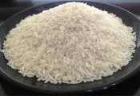


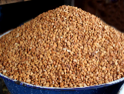

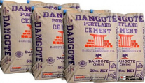




Domestic Commodities Price Movement
Relatively Inelastic Products
Commodities | Current Prices | Previous Month Prices | Directional Change | 1-Year Low | 1-Year High
Garri (50kg) Yellow | N6,250 | N6,150 |  | N6,150 | N16,000
Rice (50kg) | N14,000 | N14,000 |  | N13,000 | N22,000
Flour (50kg) | N11,000 | N11,000 |  | N8,500 | N11,100
Beans (Oloyin)(50kg) | N24,000 | N20,000 |  | N12,000 | N34,000
Cement (50kg) | N2,550 | N2,550 |  | N1,400 | N2,700
Tomatoes (50kg) | N6,000 | N7,000 |  | N6,000 | N20,000
Pepper (bag) | N6,000 | N7,000 |  | N5,000 | N15,000
Mixed movement in domestic commodity prices

Slide 6
Consumer Goods – Current price
Supermarket price
Goods
Street price
% difference
Pepsi (50cl)
N100
N100
0%
Beer (60cl)
N260
N300
-15.30%
Bread Loaf
N350
N400
-12.5%
Indomie (1 carton)
N1,900
N2,100
-15.5%
Gala (big size)
N100
N100
0%
Domestic food prices remain flat

Slide 8


Stock Market
NSE ASI 0.12% to 29,193.42pts on April 10th
Consumer goods sub index: 0.44% at 649.99pts
 | Share Prices (N) | Daily % Change (April 9th – 10th) | YTD (% Change)
Nestle | 1,450 | - | 2.36
Honeywell | 1.15 | 4.55 | 10.16
Flour Mills | 17 | - | 26.41
Cadbury | 10.1 | 3.81 | 1.00
Dangote Sugar | 13.55 | 0.74 | 11.15
Unilever | 34 | 2.86 | 8.11
Ikeja Hotels | 2.05 | 9.29 | 33.99
Newrest ASL | 7.05 | - | 10.76

Slide 9
Oil Markets Today
DAILY CHANGE
April 10th – 11th
CURRENT PRICE
COMMODITY
YTD
BRENT
WTI
NATURAL GAS
1.48%
0.48%
0.04%
31.36%
41.6%
8.16%
$70.67pb
$64.30pb
$2.70MBtu

Slide 10

Oil Prices
  Brent crude down 1.48% to $70.67pb
  Despite:
    Supply disruptions in OPEC nations- Iran, Venezuela and Libya
    Slash in Saudi Arabia’s production and exports

Slide 11
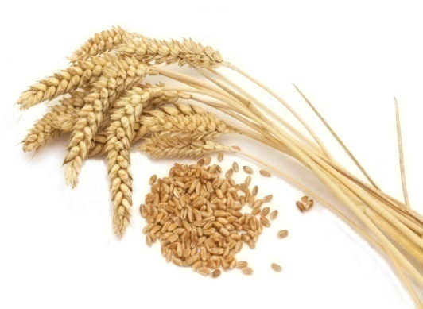

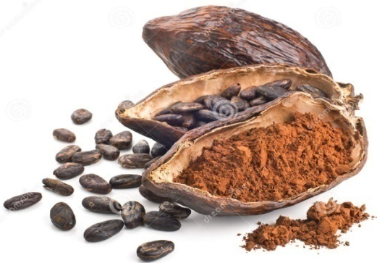

Agricultural Commodities
Wheat
Corn
Cocoa
Sugar
Graphic
Design
Wheat prices up by 0.22% to $4.59/bushel
Driven by higher demand for EU wheat
Corn prices increased by 0.28% to $3.61/bushel
Despite lower global demand
Cocoa prices rose by 0.38% to $2,418/MT
Due to high global demand for chocolate
Sugar prices down by 0.08% to 0.1289/pound
Despite adverse weather condition in India.

Slide 12

OUTLOOK – Oil Prices (2 weeks)
  Brent to trade within the range of $70-$73pb in the short term
      On tightened global supplies
        Supported by violence in Libya
  Rising US shale output could limit price gains

Slide 13
OUTLOOK – Agricultural Prices
GRAINS
  Rising global stocks to pressurize prices in the near term
Sugar
Prices to be bullish in the coming weeks on lower sugar output in Brazil
Cocoa
Expectations of bumper harvest in Ivory Coast to push prices downward in the near term
SOFTS

